Slide 1
Micro Services
Overview

Slide 2
Architectural Approach
Emphasizes the decomposition of applications into a single purpose
Loosely coupled services
Managed by cross-functional teams
For delivering and maintaining complex software systems
With velocity and quality required by todays digital business.
an architecture that embraces DevOps practices
12 Factor Apps

Slide 3
History
Microservice architecture emerged from a common set of patterns evident in companies like Amazon, Netflix, SoundCloud, and Gilt (now part of HBC Digital). Applications at these companies that were monolithic evolved over time into decomposed services that communicated via RESTful APIs and other network-based messaging protocols.

Slide 4
Graceful Service Degradation
you can isolate failures and achieve graceful service degradation as components fail separately.

Slide 5
Leaders
arun-gupta

Slide 6
Domain Driven Design

Slide 7
Service Registration and Discovery
the distinction between simpler “inner architecture” and more complex “outer architecture”.
Eureka

Slide 8
Functional Decomposition

Slide 9
Bound Context

Slide 10
Conway’s Law
organizations which design systems ... are constrained to produce designs which are copies of the communication structures of these organizations

Slide 11
CAP theorem
states that it is impossible for a distributed computer system to simultaneously provide all three of the following guarantees

Slide 12
Aggregator Pattern #1
Service a, b, c

Slide 13
Leader Election
is the process of designating a single process as the organizer of some task distributed among several computers (nodes).

Slide 14
Registries
Eureka – Service Discovery
Zoo Keeper is a centralized service for maintaining configuration information, naming, providing distributed synchronization, and providing group services. All of these kinds of services are used in some form or another by distributed applications.
Apache Curator wrapping API.

Slide 15
Eventual consistency

Slide 16
ELK Stack

Slide 17
Event Sourcing
Save json to database
Capture all changes to an application state as a sequence of events.

Slide 18
N1QL
Json SQL
Couchbase

Slide 19
CQRs
Command Query Responsibility Segregation.

Slide 20
Common patterns in distributed systems
configuration management
service discovery
circuit breakers
intelligent routing
micro-proxy
control bus
one-time tokens
global locks
leadership election
distributed sessions
cluster state

Slide 21
Zuul
Zuul is an edge service that provides dynamic routing, monitoring, resiliency, security, and more.

Slide 22
zipkin
Zipkin is a distributed tracing system. It helps gather timing data needed to troubleshoot latency problems in microservice architectures.
it manages both the collection and lookup of this data. Zipkin’s design is based on the Google Dapper paper.
This project includes a dependency-free library and a spring-boot server. Storage options include in-memory, JDBC (mysql), Cassandra, and Elasticsearch.

Slide 23
Problem
The granularity of APIs provided by microservices is often different than what a client needs.

Slide 24
Netflix/Hystrix
Hystrix is a latency and fault tolerance library designed to isolate points of access to remote systems, services and 3rd party libraries, stop cascading failure and enable resilience in complex distributed systems where failure is inevitable.

Slide 25
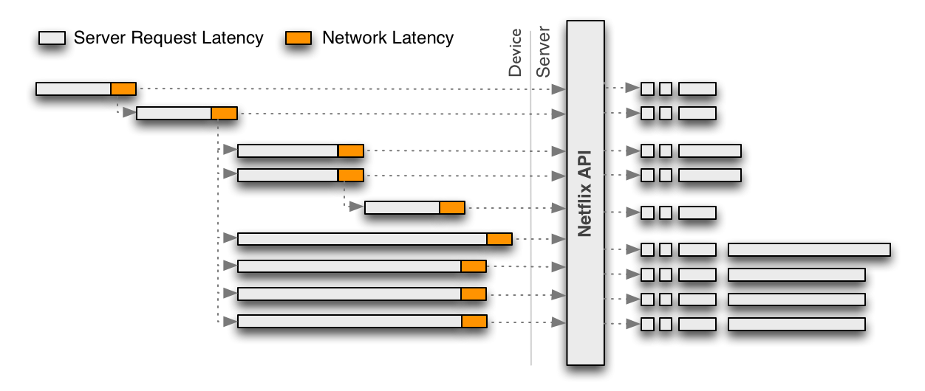
Traditional Approach

Slide 26
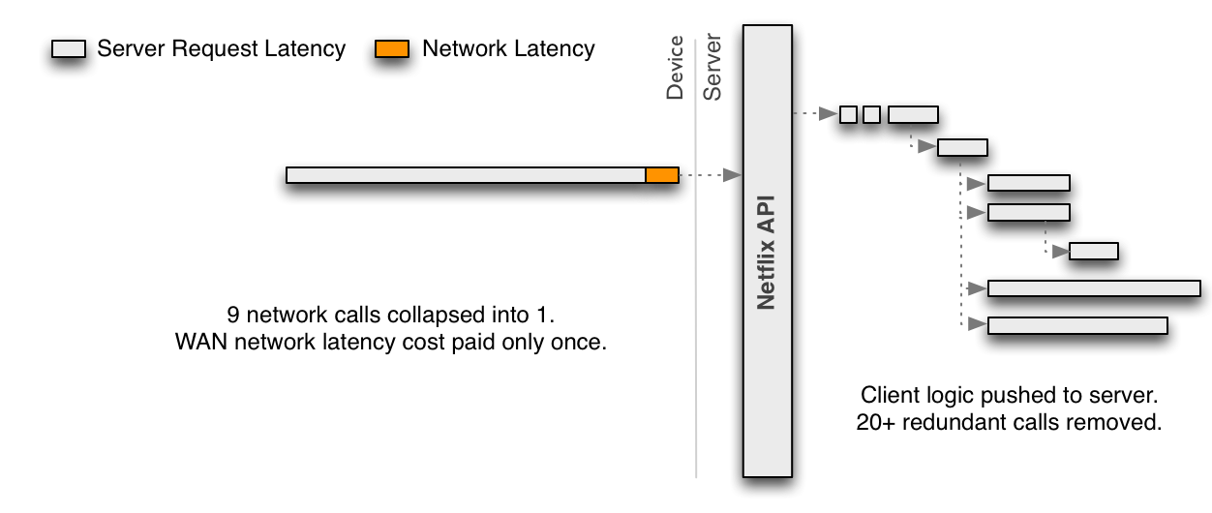
Next Approach

Slide 27
Strategies for connecting
Direct Client‑to‑Microservice Communication
This approach also makes the client code much more complex.
this approach is that it makes it difficult to refactor the microservices.
Using an API Gateway
is similar to the Facade pattern from object‑oriented design.
The API Gateway is responsible for request routing, composition, and protocol translation.
A major benefit of using an API Gateway is that it encapsulates the internal structure of the application.

Slide 28
API Gateway
The API Gateway handles some requests by simply routing them to the appropriate backend service. It handles other requests by invoking multiple backend services and aggregating the results.

Slide 29
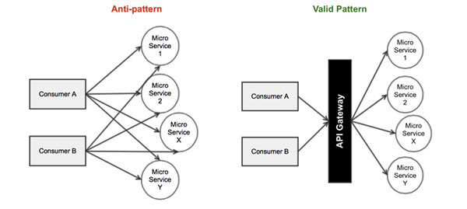
Microservice Patterns

Slide 30
REST API Gateway
Using an API gateway has the following benefits:
Insulates the clients from how the application is partitioned into microservices
Insulates the clients from the problem of determining the locations of service instances
Provides the optimal API for each client
Reduces the number of requests/roundtrips. For example, the API gateway enables clients to retrieve data from multiple services with a single round-trip. Fewer requests also means less overhead and improves the user experience. An API gateway is essential for mobile applications.
Simplifies the client by moving logic for calling multiple services from the client to API gateway
The API gateway pattern has some drawbacks:
Increased complexity - the API gateway is yet another moving part that must be developed, deployed and managed
Increased response time due to the additional network hop through the API gateway - however, for most applications the cost of an extra roundtrip is insignificant.
Issues:
How implement the API gateway? An event-driven/reactive approach is best if it must scale to scale to handle high loads. On the JVM, NIO-based libraries such as Netty, Spring Reactor, etc. make sense. NodeJS is another option.

Slide 31
Data Bus Microservice REST API Gateway
Dynamic Endpoints
Endpoint Code Repository and Management
Backend Services and Dependencies
Dynamic Polyglot JVM Language Runtime
Asynchronous Java API + Reactive Programming Model
Hystrix Fault Tolerance

Slide 32
AWS Lambda
Function as a Service (FaaS)
Event Driven
Serverless computing, also known as function as a service (FaaS)
Lambda only runs on AWS

Slide 33
Amazon Elastic Compute Cloud (EC2)
forms a central part of Amazon.com's cloud-computing platform, Amazon Web Services (AWS), by allowing users to rent virtual computers on which to run their own computer applications.

Slide 34
Cloud Foundry
open platform as a service – PAAS
You manage Applications and Data
Cloud platforms represent the next step in the evolution of IT, enabling you to focus exclusively on your applications and data without worrying about underlying infrastructure.
deploy on an IaaS like AWS, vSphere, or OpenStack
Cloud Foundry is ideal for anyone interested in removing the cost and complexity of configuring infrastructure for their apps.

Slide 35
Cloud Foundry Elastic Runtime
framework that hosts your running applications (DEAs), manages the system health, provides consolidated application logging , and the api endpoint and broker(cloud controller) that are all running on virtual machines that Ops Manager provisioned.

Slide 36
Cloud Foundry Subsystems
BOSH
an open source tool for release engineering, deployment, lifecycle management, and monitoring of distributed systems.
creates and deploys virtual machines (VMs) on top of a physical computing infrastructure, and deploys and runs Cloud Foundry on top of this cloud. To configure the deployment, BOSH follows a manifest document.

Slide 37
Cloud Foundry Subsystems
Cloud Controller
The Cloud Controller provides REST API endpoints for clients to access the system. The Cloud Controller maintains a database with tables for orgs, spaces, services, user roles, and more.

Slide 38
CF Push

Slide 39
Moving to Microservices
Refactoring to Microservices can decouple code and resources, make builds smaller, releases safer, and APIs more stable.

